Slide 1



OSLO Air and Water:
Workshop 1
Welcome!
Tuesday February 9th 2021
Virtual working group – Microsoft Teams

Slide 2
Purpose of today
Reviewing the use case and brainstorm on the data model
Give a recap of the business workshop
Presentation and discussion on the
use case
First brainstorm and discussion on the data model with a focus on the observations

Slide 3
Agenda
Welcome and introduction (15’)
Recap: what did we do in the previous workshop and the different “levels of information” (25’)
A first attempt for the model: feedback and brainstorming (100’)
Next steps (10’)

Slide 4



Practicalities
Audience sound is muted by default
Use your hand if you want to say something. Interaction is encouraged!
Questions, comments and suggestions can be communicated via the chat function. Interaction is encouraged!
yes/no questions can be answered via chat:
Agree = +1
Do not agree = - 1
Indifferent = 0

Slide 5
Welcome and introduction

Slide 6

Who’s in the room?
5’
https://app.klaxoon.com/participate/board/T9ZKYVV

Slide 7

Scope of the project
Design a semantic interoperability framework for sharing and publishing environmental data
Develop a sustainable vocabulary and application profile for water and air quality.
Open & Agile Smart Cities (OASC)
ODALA
OSLO trajectory
Flanders Information Agency

Slide 8
Scope of the project
Design a semantic interoperability framework for sharing and publishing environmental data
We follow the OSLO methodology, which means that:
We start from use cases
We align with and reuse existing international standards
We define things ourselves only when needed
We focus on the exchange of data collected via sensor technology within the context of monitoring Air and Water Quality.
Develop a sustainable vocabulary and application profile for water and air quality.

Slide 9




From a common vocabulary to different ways of expressing data
NGSI (LD)

Slide 10
Overview of the planning
Start date: December 1st, 2020
Timing: 9 months
Today
Start Public review
End Public review
Thematic Workshop
Thematic Workshop
2020
2021
December
January
February
March
April
May
June
July
August
Business Workshop
Thematic Workshop
Thematic Workshop
Implementation of draft specification

Slide 11
Recap: what did we do in the previous workshop?

Slide 12



What did we do in the previous workshop?
Introduction
Scope & objectives
Timeline
OSLO
ODALA
OASC
...
Showcasing existing standards and use cases
SSN: Semantic Sensor Network
SOSA: Sensor, Observation, Sample, and Actuator
SAREF: Smart Applications REFerence
Smart Data Models
OPEN DEI
Brainstorm exercise
What is the scope of the use case?
What do you want to measure in the use case?
What data do you need prior and post the use case?

Slide 13
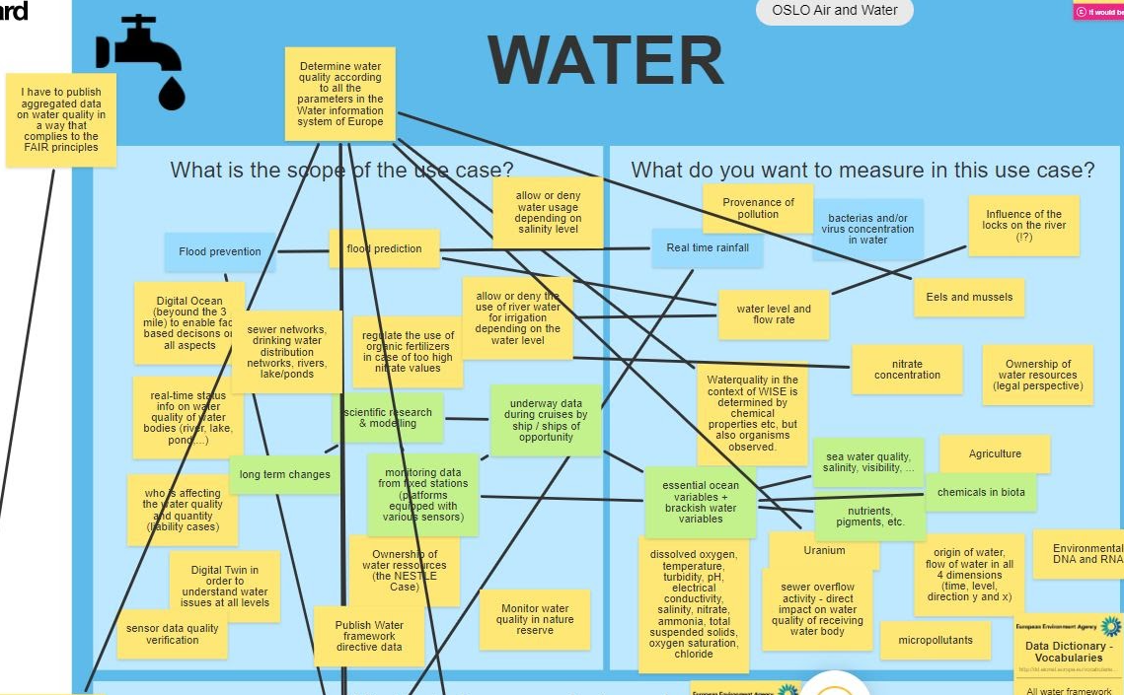
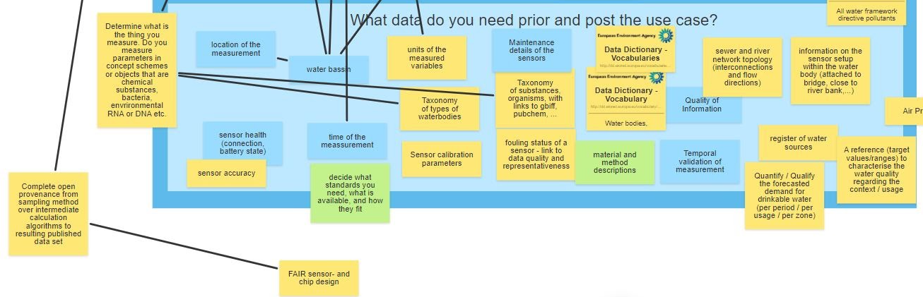
Remember this?

Slide 14

Results of the brainstorm: water
Water
What is the scope of the use case?
Flood prediction and prevention
Scientific research and modelling
Real-time status information on water quality of water bodies
Who is affecting the water quality and quantity
Sensor data quality verification
What do you want to measure?
Indicators such as dissolved oxygen, temperature, turbidity, pH, ammonia, ...
Water level and flow rate
Bacterias and/or virus concentration in water
Ownership of water resources (legal perspective)
Provenance of pollution
What data do you need?
Sensor related data
Sensor health (connection, battery state e.g.)
Maintenance details of the sensors
Information on the sensor setup within the water
Sensor accuracy
Sensor calibration parameters
Metadata on measurements
Quality of the information
Time of measurement
Temporal validation of measurement
Other examples include:
Sewer and river network topology
A reference to characterise the water quality regarding the context/usage

Slide 15

Results of the brainstorm: air
Air
What is the scope of the use case?
Build sensor grids to be able to measure Air Quality on household level.
Making citizens aware of Air Quality
Support intelligent traffic management with Air Quality Data.
Determine the provenance of the pollution
Air Quality forecasting
Impact of pollution prevention policy
What do you want to measure?
Many specific chemical notations of measurements were given e.g. O3, NOx, SO3, NO, NO2, NH3, CO, H2S, …
Temperature, pressure, humidity, …
What data do you need?
Sensor related data
Maintenance details of the sensors
Device information
Metadata on measurements
Quality of the information
Time of measurement
Temporal validation of measurement
Meta information on the sensors and measurements
Unique ID’s on each emission point
Other examples include:
Data about emission points of all substances
Pollution origins estimation

Slide 16
Different “categories of information”
15’
4 areas on which information is needed supporting the use cases
Measurement itself, e.g.
Value and measuring unit
Data Quality information (e.g. Accuracy, Frequency, …)
...
Data about the context of the measurement
Time
Location (X, Y, Z)
Object (e.g. which river, lake, …)
...
Data about the measurement device
Which device
How old is the device
What is the state of the device
Administrative metadata
Owner
Disclaimer
License
Contact point
For these areas: what is the data that needs to be exchanged in a smart city context?
Think about elements (classes and/or attributes)

Slide 17
A first attempt for the model: feedback and brainstorming

Slide 18

Use case storyline
A government institution in Madrid would like to monitor the air quality of the city by measuring substances in the air on different locations throughout the city.
To accomplish this, they have placed several sensors across the city to capture the required air quality data.
The institution would like to measure data such as CO- and SO2-concentration but also needs accurate weather information like precipitation, relative humidity, wind direction, wind speed and temperature.

Slide 19

Use case storyline Simplified version of the class model
Observation information
The activity of observing
At what time?
Observation parameters?
...
Observation

Slide 20
Use case storyline Simplified version of the class model
FeatureOfInterest
Feature of interest
What object do we observe?
A lake
The air in Madrid
Sampling feature
We cannot sample the entire lake or air surrounding madrid, so we use specific sample points to represent the object
What proxy object do we observe?
Location
Sample
Observation
SamplingFeature

Slide 21
Use case storyline Simplified version of the class model
Sensor information
Sensor information
What are the features of interest regarding our sensor?
What sensors were used?
Installed on which platform?
...
Observation

Slide 22
Use case storyline Simplified version of the class model
Procedure information
How was the observation made?
Sensor
Algorithm
Analysis
...
Observation
Procedure

Slide 23
Use case storyline Simplified version of the class model
Metadata information
Who produced the observation?
When?
Status of the observation: archived/cancelled/planned/acquired/…
Information on processing of the data
...
Observation
Metadata

Slide 24
Use case storyline Simplified version of the class model
Observable property
Observable property
What property do we observe?
Observation

Slide 25
Use case storyline Simplified version of the class model
Observation
Result information
In the end you want to get a certain result, which is derived from the gathered data e.g.
Value of the observation
0.5 ppm
Level of the observation
Excellent - Good - Poor - Alarming
We are below the threshold
Red - Green - Orange
…
Result
Notes:
Check if any question

Slide 26
15’
Does this make sense?
Do we cover all aspects of the use case?
Are we missing crucial pieces of information?

Slide 27
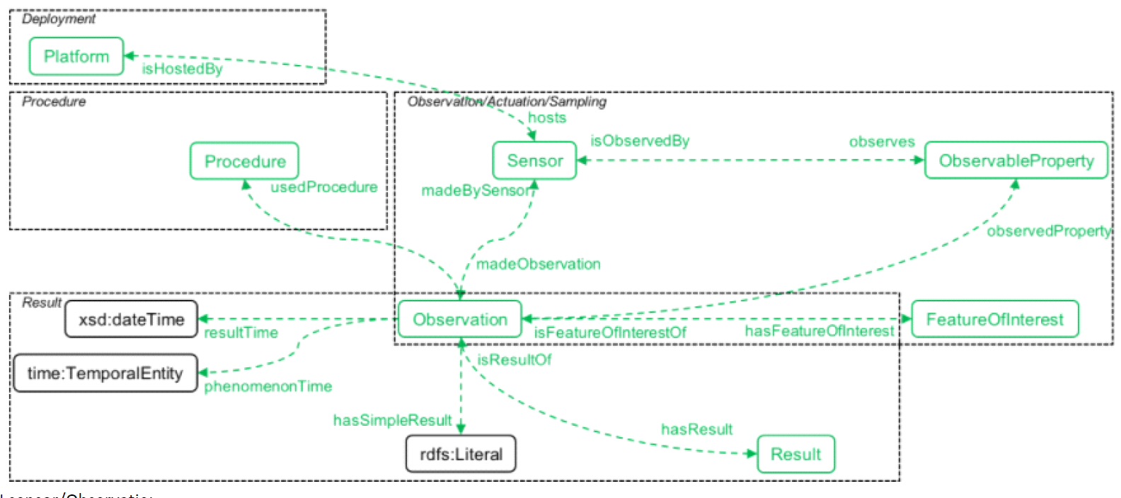
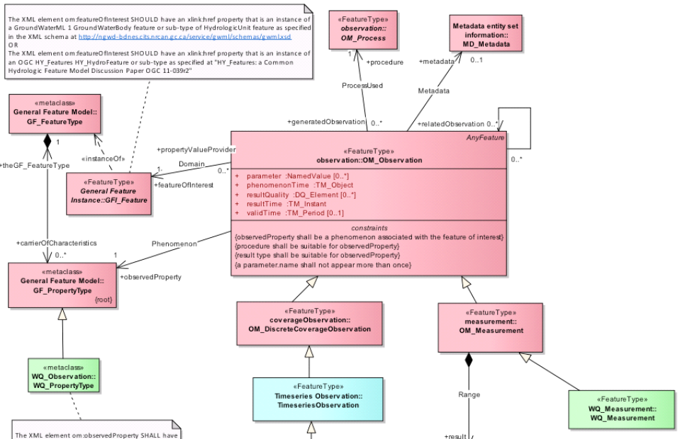
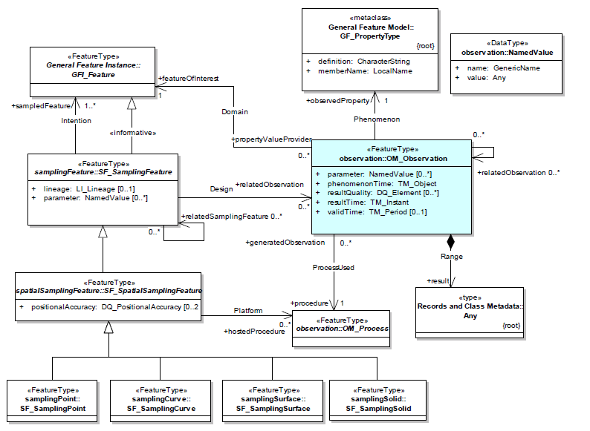
Initial thoughts of comparison
SOSA
Outcome assessment of existing standards
Existing standards like SOSA, WaterML, INSPIRE AC build on ISO O&M
Mainly reuse of the ‘Observation’ schema
Other standards mainly introduce or elaborate on additional elements such as:
sensor data (SOSA)
timeseries (WaterML)
Quantity types via QUDT (WaterML)
ISO O&M itself builds further on existing standards like:
OGC Spatial Coverage
ISO Metadata
WaterML
INSPIRE Atmoshperic conditions

Slide 28
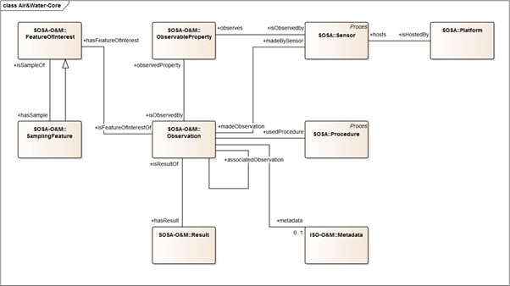
Use case storyline Building the UML class model
SOSA Observation + elements from SOSA Sampling & ISO O&M:

Slide 29
15’
Do you agree with the fact that O&M and SOSA form a good basis for our common vocabulary?
Is the UML class model clear?
Are we missing crucial pieces of information?
Are there any questions?
Any use cases you want to test the model with?

Slide 30
Short break
Let’s take a 10 minute break!
Restarting at 14:40

Slide 31
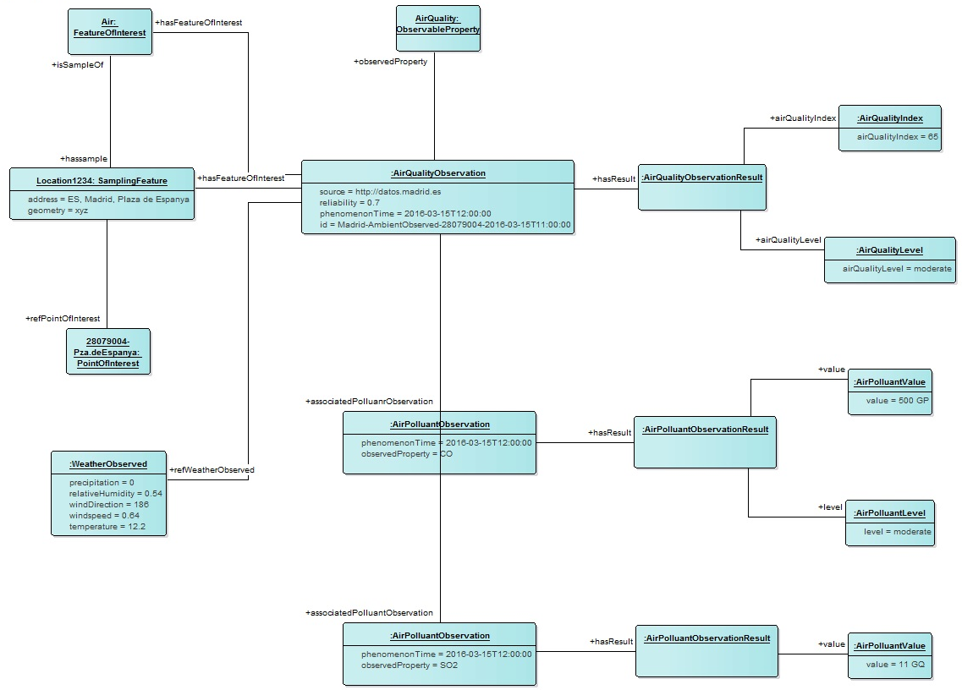

Another example: object diagram
Based on the input from the previous workshop we have created a preliminary object diagram to showcase the previously depicted use case

Slide 32
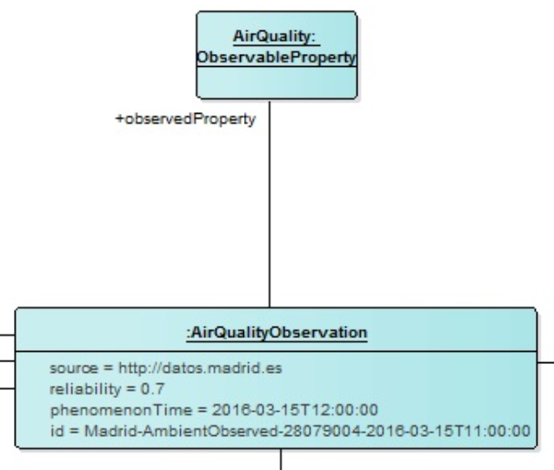
Object diagram
Air Quality Observation main object
What do we observe?
Airquality

Slide 33
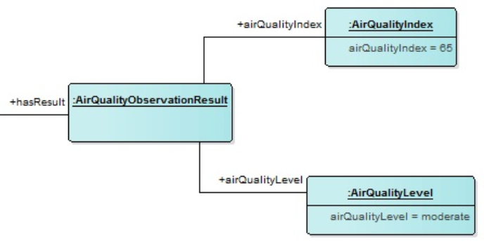
Object diagram
Air Quality
What is the overall air quality of the observation?
Air quality level
Linked to an index

Slide 34
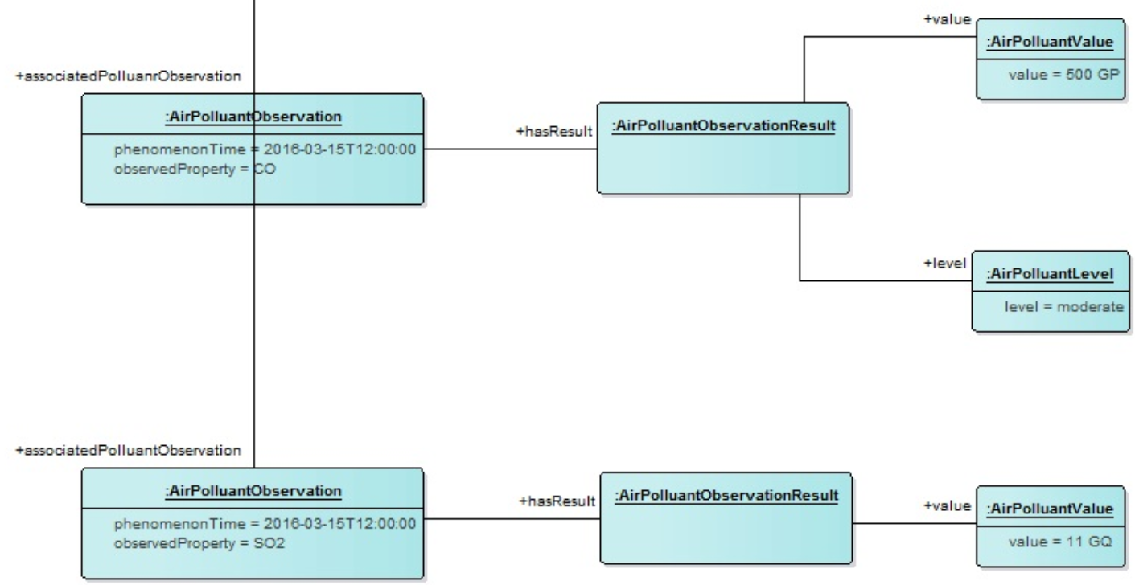
Object diagram
Air Pollutants
Which are the pollutants measured and what are their values?
CO
Level
Measured value
SO2
Measured value

Slide 35
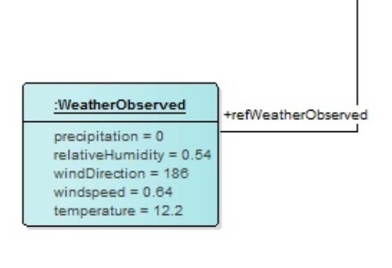
Object diagram
Weather observations
How are the weather conditions on the moment of measuring?
Precipitation
Relative humidity
Wind direction
Wind speed
Temperature

Slide 36
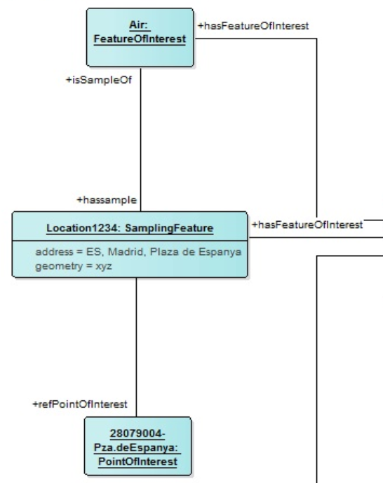
Object diagram
Feature of interests
Where does our measurement originate from?
Location
Address
Geometry
Linked to a Point of Interest

Slide 37

Open questions and discussion
20’
How similar is this for Water? What is missing? What is different, what is the same?
Do we cover all use cases?
Flood prediction: water height, weather, …
Do we cover all types of observations?
What use cases would you like to see to test the model with
What information/classes needs to be added/detailed?
Sensors
Time series
Weather info
Procedure
...
What questions do you have? What questions do we need to address in the upcoming webinars?

Slide 38
Next steps

Slide 39
Next steps
Thematic workshop on the 4th of March (13h-15h30 CET) Don’t forget to subscribe!
https://overheid.vlaanderen.be/opleiding/oslo-air-and-water-model
Today
Start Public review
End Public review
Thematic Workshop
Thematic Workshop
2020
2021
December
January
February
March
April
May
June
July
August
Business Workshop
Thematic Workshop
Thematic Workshop
Implementation of draft specification

Slide 40
Next steps – In the meanwhile...
Reviewing the model and submitting feedback/questions via mail or GitHub
Reviewing the definitions and submitting feedback/questions via mail or GitHub
Provide input on additional use cases
Analyse additional existing data specifications

Slide 41
List of data specs
FIWARE AirQualityObserved
FIWARE WaterQualityObserved
ISO Observations & Measurements (O&M)
Sensor, Observation, Sample and Actuator (SOSA)
WaterML
QUDT - Quantitykind
INSPIRE - Environmental Monitoring Facilities
INSPIRE Atmospheric Conditions
Any other?

Slide 42
Focus of the next webinar
Finetuning and extending the model
In-depth discussion on the attributes
Review and get feedback on the definitions

Slide 43

Feedback & collaboration
Feedback can be provided by email to the following people:
annelies.decraene@vlaanderen.be
michiel.dekeyzer@vlaanderen.be
dries.catteceur@vlaanderen.be
Feedback/input can be provided through GitHub: https://github.com/Informatievlaanderen/OSLOthema-airAndWater
Please provide us with your username so we can invite you!

Slide 44

Are there any questions left?

Slide 45
Thanks!

